Slide 1


Big Data Projects
HARPE
DATA
SCIENCE

Slide 2



Web Automation in R
Automation
HA UG
2022

Slide 3
Web Automation in R
Automation
HA UG
2022

Slide 4

Github webpage
R analysis

Slide 5

LME + blocking
R analysis

Slide 6


Data Viz

Slide 8
NLP
Sentiment analysis
HARPE
DATA
SCIENCE

Slide 9
Sample size?
R simulation

Slide 10
NLP basics
HARPE
DATA
SCIENCE

Slide 11
T-test
R Bootcamp
2.5

Slide 12
Regression
R Bootcamp
2.4

Slide 13
Correlation
R Bootcamp
2.3

Slide 14
Distributions
R Bootcamp
2.2

Slide 15
summarizing
data
R Bootcamp
2.1
HARPE
DATA
SCIENCE

Slide 16
HAP-E
Machine learning
concept
HARPE
DATA
SCIENCE

Slide 17
HAP-E
Stats basics
HARPE
DATA
SCIENCE

Slide 18
HAP-E
Data wrangling
HARPE
DATA
SCIENCE

Slide 19
HAP-E
Python graphs
HARPE
DATA
SCIENCE

Slide 20

HAP-E
Python setup
HARPE
DATA
SCIENCE

Slide 21
manipulating
data
R Bootcamp
1.5
HARPE
DATA
SCIENCE

Slide 22
R Bootcamp
1.4
HARPE
DATA
SCIENCE

Slide 23
R Bootcamp
1.3
HARPE
DATA
SCIENCE

Slide 24

Github
Website
HARPE
HARPE
DATA
SCIENCE
SCIENCE

Slide 25


R Bootcamp
0.0 overview
HARPE
HARPE
DATA
SCIENCE
SCIENCE

Slide 26

R Bootcamp
0.1 RStudio
HARPE
HARPE
DATA
SCIENCE
SCIENCE

Slide 27
R Bootcamp
1.1 R Syntax
HARPE
HARPE
DATA
SCIENCE
SCIENCE

Slide 28
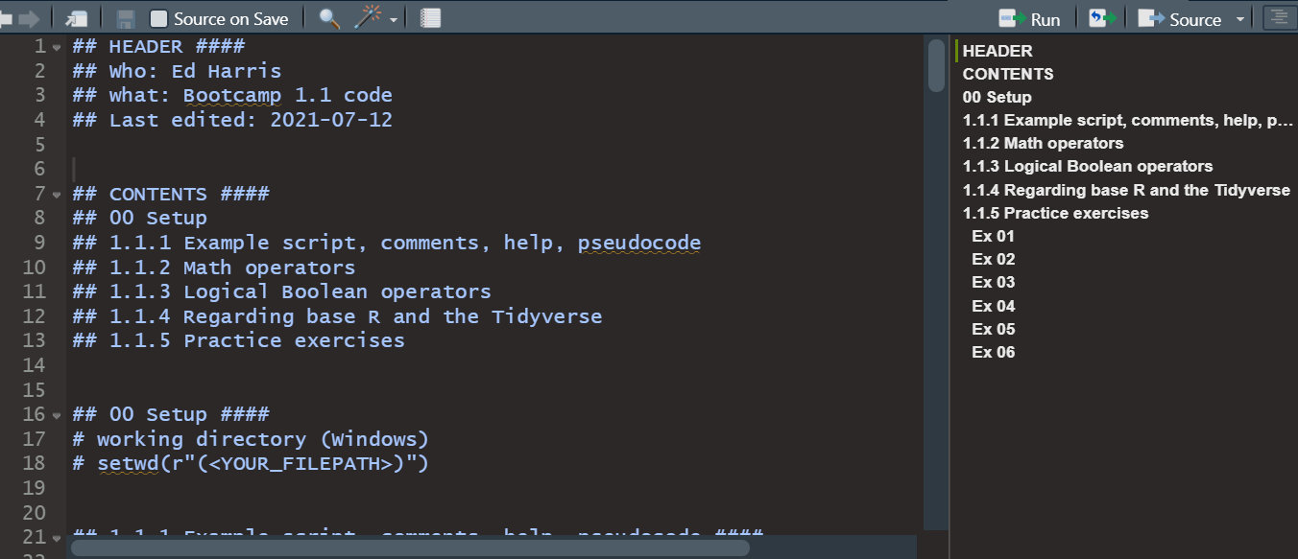
R Bootcamp
1.1 R Syntax
HARPE
HARPE
DATA
SCIENCE
SCIENCE

Slide 29
R Bootcamp
1.2 Functions
HARPE
HARPE
DATA
SCIENCE
SCIENCE

Slide 30
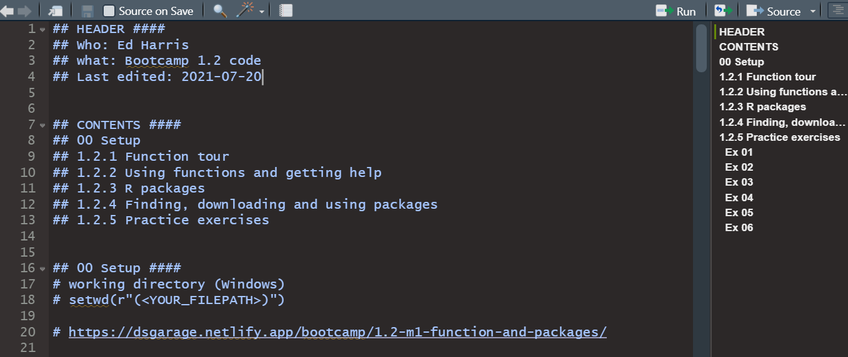
R Bootcamp
1.2 Functions
HARPE
HARPE
DATA
SCIENCE
SCIENCE

Slide 31


Q
C7081
2021
antine

Slide 32
Q
antine
Q
antine

Slide 33


HARPE
D
D
HARPE
HARPE
T
T
A
A
2021
HA UG!
D
HARPE
T
2021
A

Slide 34
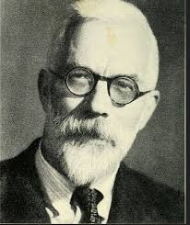
HARPE
HARPE
DATA
SCIENCE
HARPE
HARPE
DATA
SCIENCE

Slide 35


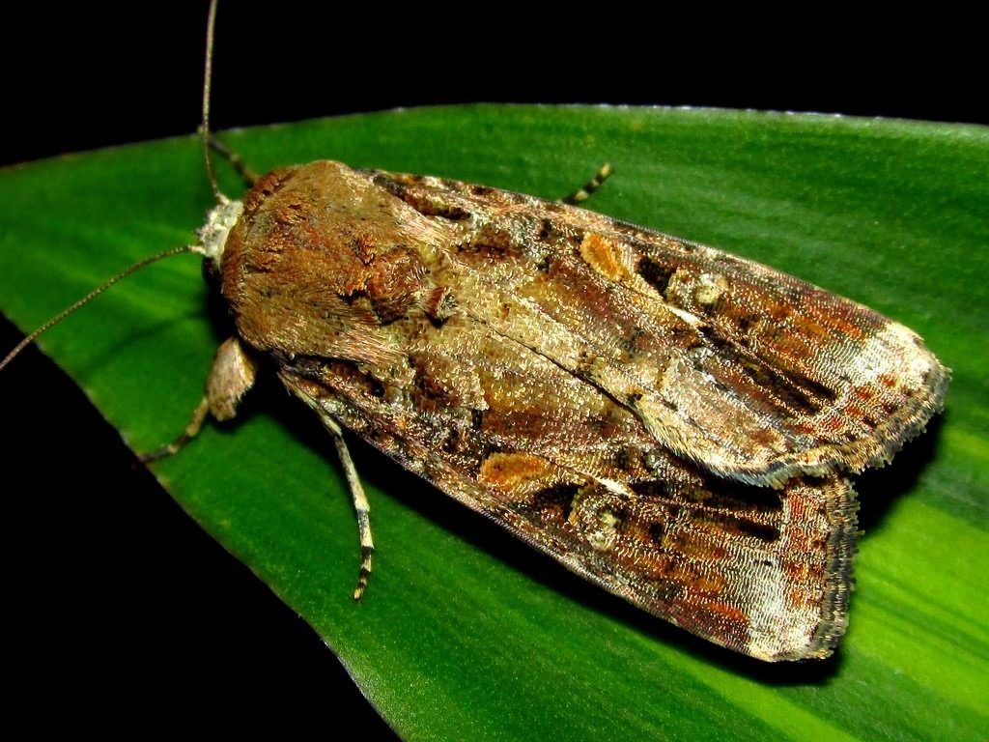























DS
EDA
2021
GA
AGE
DS
2021
DATA
SCIENCE
DS
GA
AGE

Slide 37

shinycustomloader
shinycustomloader
shinycustomloader
shinycustomloader
shinycustomloader
shinycustomloader
shinycustomloader
shinycustomloader
http://hexb.in/sticker.html

